Slide 1
Policy Editor
Module 7

Slide 2
Module Objectives
Upon completion of this module, you will be able to:
Navigate the McAfee SIEM policy editor.
Create, modify and delete McAfee SIEM policies within the policy editor.
Configure individual rules within policy editor to meet your needs.
Create custom Advanced Syslog Parser rules to parse custom application logs received over Syslog

Slide 3

Module Topics
Policy Editor Overview
Policy Editor Navigation
Configuring McAfee SIEM Policies
Rule Types
Rule and Variable Configuration
Advanced Syslog Parser

Slide 4
Policy Editor Overview
Policy Editor is the central point of configuration for data source parsing; rule configuration; and event aggregation and packet storage settings
The behavior of devices and data sources depends upon a properly configured policy
The policy editor provides a easy-to-use interface for creating policy templates and configuring these templates to accurately represent your environment and operational needs
The policy editor is one of the most important components within the McAfee SIEM solution
Significant effort should be spent configuring policies during initial set up, as a highly tuned and accurate policy will greatly add to the operational usability of your SIEM

Slide 5

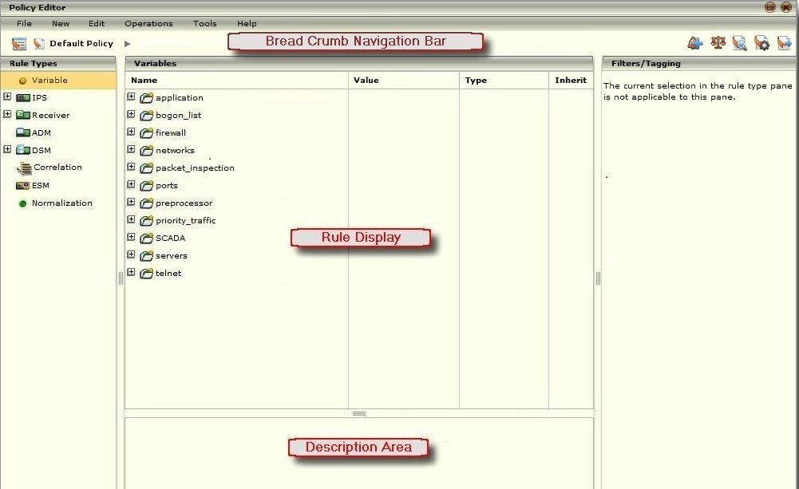
Policy Editor
Policy Editor can be accessed from the quick launch toolbar
The policy editor interface was designed with ease-of-use and operational efficiency in mind
Bread Crumb Navigation
Rule Display
Description Area
Filters/Tagging
Data Source Tree Navigation
Notes:
Bread crumb navigation provides links back to each previous page navigated to get to the current page being displayed. It essentially provides a trail to follow back to the starting point.
The rule display area provides an intuitive drill down interface into individual rule and variable settings.
The description area gives detailed information concerning the rule you have selected. It can be enlarged by placing your cursor on the divider bar and clicking and dragging the line up to the desired height. This provides you the ability to view all of the rule’s detailed information, without having to scroll up and down.
Filters/Tagging provides the ability to search within the policy editor for specific categories of rules grouped by a tag or filter option.
The data source tree navigation provides a tree style drill down to access data source specific variables and rules for configuration.

Slide 6
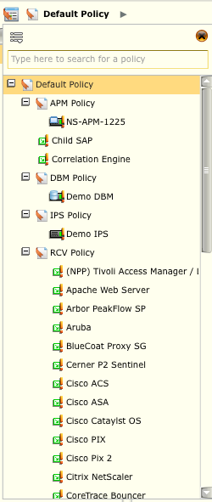
Policy Tree
The Policy Tree can be accessed by clicking the Policy Tree icon ( ) in the bread crumb navigation bar
The Policy Tree allows you to View the detailed information regarding any item on the tree by double-clicking on the name or single-clicking on it and then closing the Policy Tree.
The information for the selected item will be displayed on the Policy Editor dialog.
NOTE
Devices can only be dragged and dropped into Policies
Notes:
The Policy Tree lists the policies and devices on the system. It allows you to navigate to view the details of a specific policy or device, add a policy to the system, modify the order of the policies or devices, and locate any policy or device by name. In addition, you can rename, delete, copy or copy and replace, import, or export a policy.
To access the Policy Tree, do the following:
1.Click on the node for the device that you wish to view in the System Navigation Tree.
2.Select the Policy Editor icon in the Actions Toolbar (). The Policy Editor screen will open.
3.Click on the Policy Tree icon () in the top left corner of the Policy Editor. The Policy Tree will open.
4.From here, you can do the following:

Slide 7
Policy Tree Icons
The Policy Tree could have the following icons displayed to the left of the policy name:
Policy
Device is out of sync
Device is staged
Device is up to date
Virtual device is out of date
Virtual device is staged
Virtual device is up to date
Data source is out of sync
Data source is staged
Data source is up to date
ADM is out of sync
DEM is out of sync
Notes:
The policy tree icons provide a quick reference as to the status of your policy, devices, virtual devices, and data sources with regards to policy within the SIEM.

Slide 8
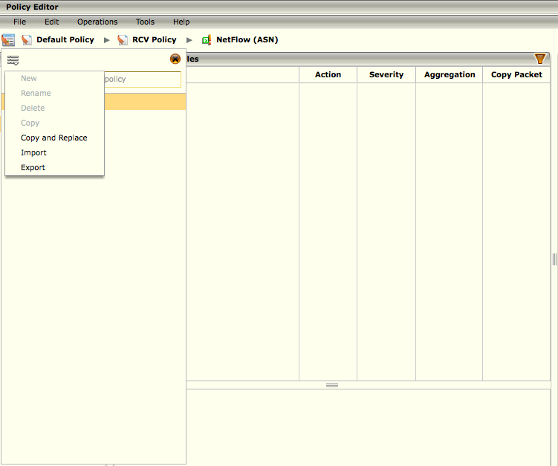
Policy Tree – Add, Delete, Rename
New: Allows you to create a new policy
Delete: Allows you to delete the current policy highlighted in the Policy Tree
Rename: Allows you to rename the current policy highlighted in the Policy Tree
NOTE
You can only rename policies, not devices
You cannot delete the Default Policy
Notes:
To add a new policy to the system, follow the steps below.
1. In the Policy Editor, click on the Policy Tree icon. A list of current policies will open.
2. Click on Default Policy or any other policy to which you want to add this new policy.
3. Click on the menu icon and select New. The New Policy dialog opens.
4 .Enter a name for the policy.
5. Click OK. The new policy will be added to the Policy Tree.
To rename a policy, follow the steps below.
1. Access the Policy Tree.
2. On the list of policies and devices, click on the policy you wish to rename.
3. Click on the Menu icon in the top left corner of the Policy Tree.
4. Select Rename. The Rename Policy dialog will open, showing the current name of the policy.
5. Enter the new name.
6. Click OK to save the changes. The renamed policy will appear in the tree.
To delete a policy, follow the steps below.
1. Access the Policy Tree.
2. On the list of policies and devices, click on the policy you wish to delete. Keep in mind that you cannot delete the Default Policy.
3. Click on the Menu icon in the top left corner of the Policy Tree.
4. Select the Delete option. A confirmation dialog will open.
5. Click on OK to continue or Cancel to stop the deletion.

Slide 9
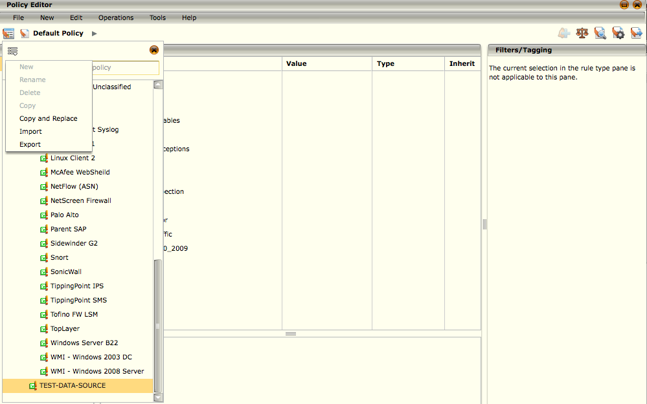
Copy of Copy and Replace a Policy
There are two ways in which you can copy a policy:
Copy an existing policy and rename it using the same settings from the copied policy
Copy an existing policy and replace the settings of another existing policy with the copied settings, without changing the name of the policy.
NOTE
These changes are not tracked so they cannot be undone.
Notes:
To copy a policy, follow the steps below.
1.Access the Policy Tree.
2.On the list of policies and devices, click on the policy you wish to copy.
3.Click on the Menu icon in the top left corner of the Policy Tree.
4.Select the Copy option. The New Policy dialog opens.
5.Enter a name for the new policy.
6.Click OK. The copied policy will be added to the tree.
To copy and replace the settings of another policy with these settings, follow the steps below.
1.Access the Policy Tree.
2.On the list of policies and devices, click on the policy you wish to copy.
3.Click on the Menu icon in the top left corner of the Policy Tree.
4.Select the Copy and Replace option. The Select Policy dialog opens.
5.Click on the policy that is to be overwritten with the settings of the policy you are copying. A confirmation window will open.
6.Click on Yes to proceed or No to stop the copy and replace action. If you clicked Yes, the settings of the policy you copied will be applied to the policy you selected, but the name of the selected policy will remain the same.

Slide 10
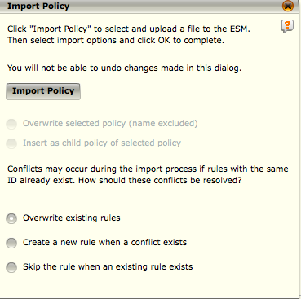
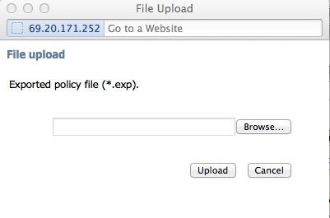
Import a Policy
Importing a policy allows you to import a previously exported policy file
NOTE
The import will occur from the currently selected node down.
These changes are not tracked so they cannot be undone.
Notes:
To import a policy, follow the steps below.
1.Access the Policy Tree.
2.On the list of policies and devices, select the level on the tree where you want to import the new policy.
3.Click on the Menu icon in the top left corner of the Policy Tree.
4.Select Import. The Import Policy screen will open.
5.Click on the Import Policy button to upload the file. The File Upload dialog appears.
6.Browse to the file you want to import and then select Upload. Once this file is uploaded, its contents will be reviewed by the application and the appropriate options will be enabled or disabled, depending on the contents of the selected file.
7.Select the desired import options, which are explained below.
To select where and how to import the policy contained in the file, select one of the following:
Overwrite selected policy (name excluded) will import the policy settings into the currently selected item in the policy tree. If importing multiple policies, the first policy will overwrite the currently selected policy and all subsequent policies will be inserted as children of the current node, leaving their hierarchical relationship intact. Note that this option will not change the name of the currently selected policy.
Insert as child policy of selected policy will import the policy as a child of the currently selected item in the policy tree. If importing multiple policies, all policies will be inserted as children to the current node, leaving their hierarchical relationship intact.
To select the action to be taken should rules being imported have the same ID as existing rules, select one of the following:
Overwrite existing rules will delete the existing rule and overwrite it with the rule that is part of the policy being imported.
Create a new rule when a conflict exists will keep both of the rules, creating a new ID for the imported rule.
Skip the rule when an existing rule exists will keep the existing rule and will not import the conflicting rule.
8.Once you have made your selections, click on OK.

Slide 11
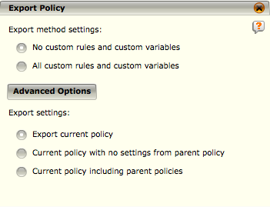
Export a Policy
Allows you to export policy settings to a file so they can be imported in the future
Export Method Settings options allow you to select whether you want custom rules and variables to be included as part of this export.
Export current policy will export the policy with all its parent hierarchy
Current policy with no settings from parent policy will export only the currently selected policy's settings
Current policy including parent policies will export the selected policy and all of its parents, with the hierarchical structure kept intact
Notes:
To perform an export, follow the steps below.
1.Access the Policy Tree.
2.On the list of policies and devices, select the level on the tree that you want to export. The export will include the currently selected node and up in the hierarchy. Only the custom rules will be exported so at least one custom rule has to be in the selection for the Export option to be enabled.
3.Click on the Menu icon () in the top left corner of the Policy Tree.
4.Select Export. The Export Policy screen will open.
5.The Export Policy screen will open. Select the desired export options, which are explained below:
•The Export Method Settings options allow you to select whether you want custom rules and variables to be included as part of this export. Due to the possible dependency of custom rules on custom variables, custom rules cannot be exported without also exporting the custom variables. Select the custom rules and variables option that best suits the desired action for the current export.
•To select the levels of the policies that are to be exported, click on Advanced Options. The following options will be added to the dialog:
O Export current policy will export the policy with all its parent hierarchy. However, it will be flattened, which means the settings will be compressed down into one level of policy, with the most immediate policy's settings taking precedence on an item by item basis. For example, if you have a device selected, both policies above the selected policy will be exported. Note that you have to select a child if you want the parent of that child to be exported. Also, the currently selected policies settings will have precedence over the parent policy settings when the file is compressed down into one level of policy.
O Current policy with no settings from parent policy will export only the currently selected policy's settings.
O Current policy including parent policies will export the selected policy and all of its parents, with the hierarchical structure kept intact.
Continued on next page

Slide 12
Hidden
Notes:
6.After selecting the export settings, click OK. A dialog will appear prompting you to select a location to save the exported policy file.
7.Once you have selected the location, click OK.

Slide 13
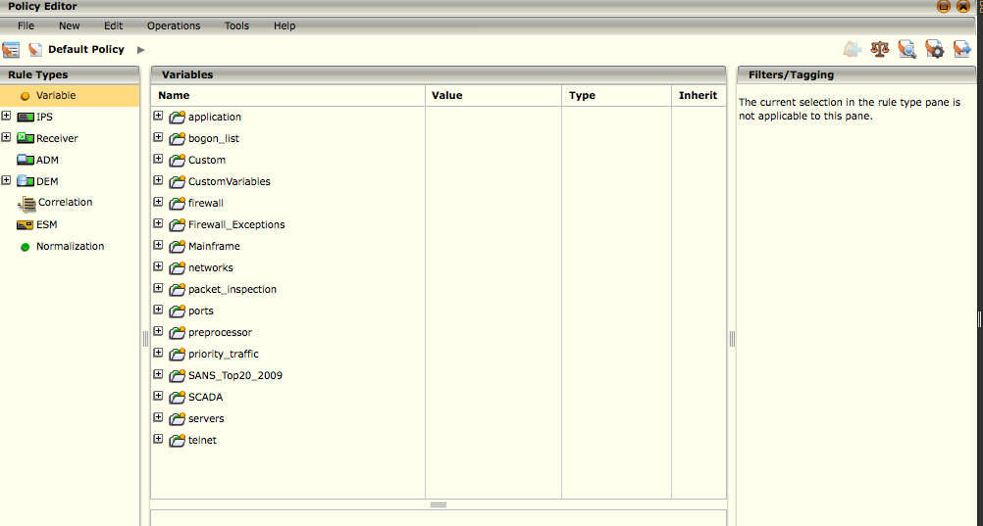
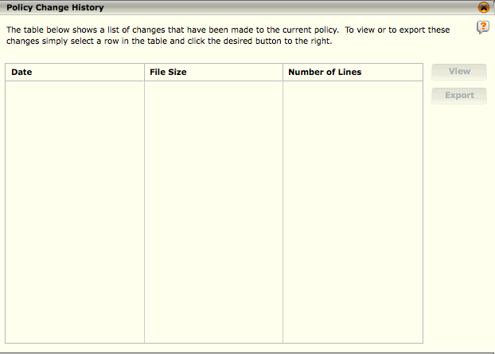
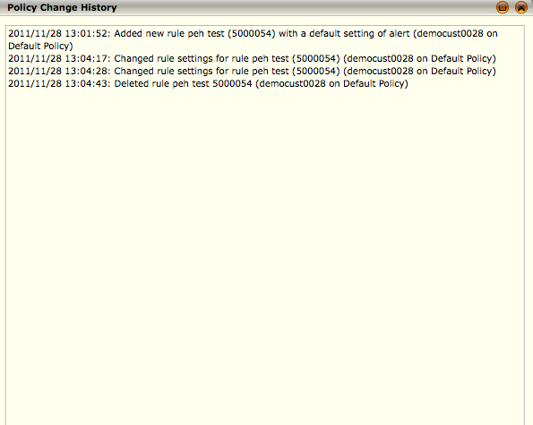
Policy Change History
The Policy Change History option allow you to view or export a log of the changes that have been made to the policy.
NOTE
This log can hold a maximum of 1 GB of data. When it reaches this limit, the oldest files will be deleted as needed.
Notes:
To view or export a log, do the following:
1.On the Policy Editor, click on the Policy Change History icon () in the top right corner. The Policy Change History dialog opens listing the different change logs that exist for the policy.
2.Do one of the following:
• To view a log on the list, click on it and click on View. The log will open showing the details of the changes that were made.
• If you want to download the log, click on Download Entire File and select the location to which it should be saved.
• To export a log, click on it and click on Export. Click Yes on the confirmation dialog that appears and then select the location to which it should be saved.
3.Click on Close to return to the Policy Editor.

Slide 14

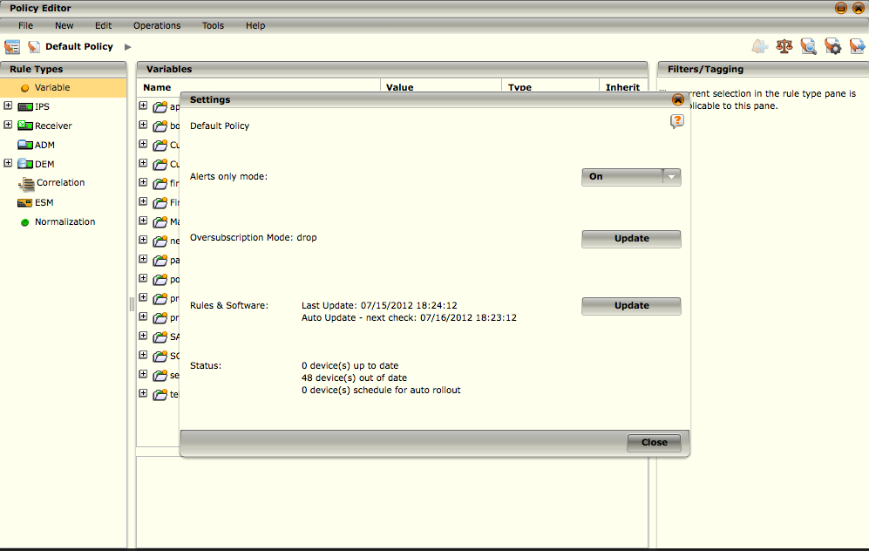
Policy Status
The status section of the Settings dialog informs you of the status of the devices on the Policy Tree.
It shows the number of up-to-date and out-of-date devices as well as the number of devices that are scheduled for auto rollout.
If the status indicates Up to date, that means that no changes have been made in the policy editor since the last time the policy was rolled out to the device.
If the status indicates Out of date, that means that changes have been made since the last time the policy was rolled out.
If a status indicates Auto Rollout, the policy has been scheduled to roll out automatically at a specific date and time.

Slide 15
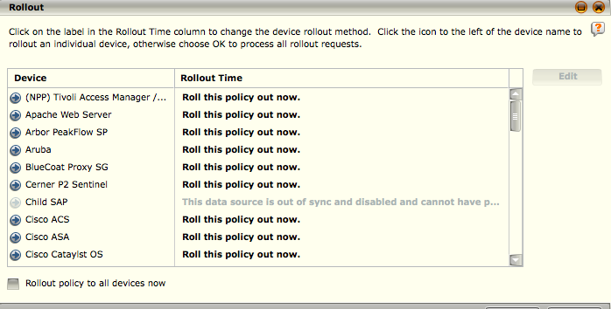
Policy Rollout
Rollout allows you to apply the current policy for one or more devices.
NOTE
Changes made at the default policy level will be applied to all policies when you rollout to all devices
If the rollout command was unsuccessful, a dialogue will open, after the last rollout has occurred, showing a summary of the failed commands.
Notes:
1. On the Policy Editor, click the Rollout icon in the top right corner of the Policy Editor. The Rollout dialog will appear showing the rollout status for each device .
2. To initiate an immediate rollout, do one of the following:
• If you want to roll the policy out to one device, click on the icon to the left of the device name in the Device column and click Yes on the confirmation window that opens.
• To rollout the policy to all the devices, check the Rollout policy to all devices now checkbox. This will cause the devices to roll out in the order that they are listed.
• To select more than one device, but not all devices, use the Shift and/or Ctrl keys.
3. To schedule a future time to execute the rollout for a device, click on the label in the Rollout Time column or highlight the device and click on Edit. The Rollout Time dialog appears. Do the following:
a. Specify when you want the rollout to occur. You have the following options:
• Stage rollout for later - This option allows you to roll out the policy at a later time. Click on this radio button then click on the calendar icon located next to the blank field. Select a date and time.
• Rollout now - If you select this option, the policy will be rolled out when you click the OK button on the Rollout dialog.
• Roll device back to previous active policy - This option allows you to roll back to the previously applied policy. It is helpful when a policy that was applied was not desirable. This option only retains one copy of the previously applied rules and will be updated every time a new successful policy application is performed. If there is no previously applied policy, this option will be inactive.
• Skip or clear staged policies - This allows you to skip the rollout option for this policy(ies).
b. Click OK to initiate the rollout. Doing so will return you to the Rollout screen.
4. After each device completes the rollout, the status of the policy will indicate a successful rollout.
Continued on next page

Slide 16
Hidden
Notes:
Rollout Policy Correlation
After creating a correlation data source, you must roll out the policy in order for the new data source to be enabled. To do so, follow the steps below.
1. In the System Navigation Tree click on the new correlation data source you created.
2. Select the Policy Editor icon in the Actions Toolbar. The Policy Editor dialog will appear.
3. In the Policy Editor dialog, the new correlation data source should already be highlighted. Verify that this is the case. (If it is not, click on the new correlation data source). Click on the Rollout button.
4. The Rollout dialog appears. The new correlation data source appears in the Device column. You can either click on the device and click OK, or just click OK to roll out the policy.

Slide 17
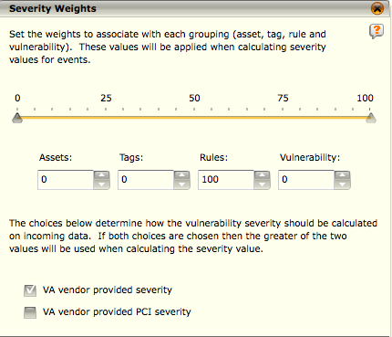
Severity Weights
To access the Severity Weights dialog, click on the Severity Weights icon in the top right corner of the Policy Editor dialog.
This screen shows the weights that are associated with the assets, tags, rules, and vulnerability groups.
Notes:
Event severity is calculated based on the severity weight given to assets, tags, rules, and vulnerabilities.
Each of the four severities is weighted in the final calculation. This final calculation is the sum of each of the four severities multiplied by their respective weights.
To change the settings on this screen, click on the up/down arrows in the Assets, Tags, Rules, or Vulnerability fields, type a number in one of the fields, or click and drag the markers on the number line. Since the sum of the settings must equal 100, when you change one setting, some or all of the other settings will be affected.

Slide 18
Severity Weights
Asset Severity - An asset is an IP address, optionally within a zone.
Tag Severity - The tag severity is calculated using both McAfee and user-defined tags. In order for a tag to be used in the severity calculation, it must be set for both the rule and asset of the event. If the rule or asset does not have any tags defined or if there were no asset matches, the tag severity will be zero. To calculate the tag severity, the number of matching rule and asset tags is multiplied by 10. The tag severity will be limited to 100.
Rule Severity - The rule severity is the severity set for the event when it was created. It is based on the event's rule severity, as set in the Policy Editor, and/or any data enrichment configured for the event's collector.
Vulnerability Severity - If VA SVE information is available for an event's asset and rule, then the highest severity of all matching asset and rule VA SVEs is used for the vulnerability severity, otherwise zero it used.
Notes:
The asset severity of an event is determined as follows:
1.The destination IP address and destination zone of the event are compared against all assets. If a match is found, the severity of that asset is used as the asset severity for this event.
2.If no destination IP address and destination zone match is found, the source IP address and source zone of the event are compared against all assets. If a source IP address and source zone match is found, the severity of the asset is used as the asset severity for this event.
3.If no matches are found, the asset severity is zero.

Slide 19
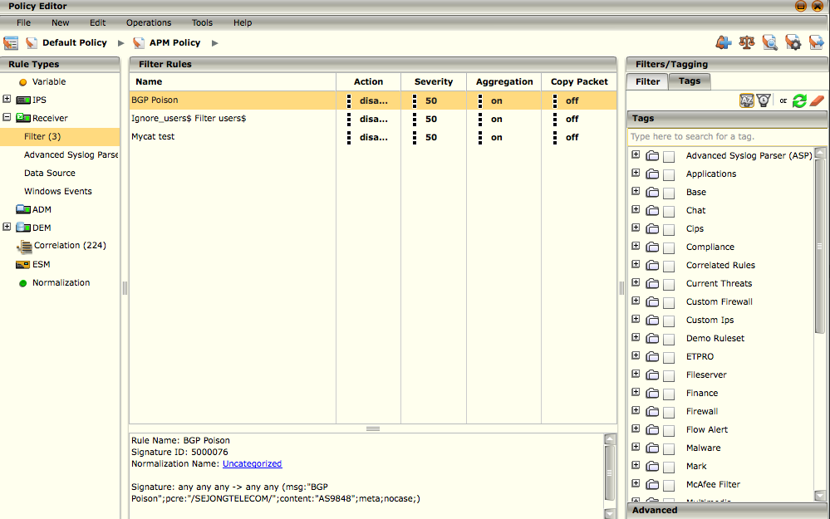
Filters
The Filters tab in the Filters/Tagging pane of the Policy Editor allows you to rules by time or filter the rules so only rules with specific settings will be listed.
NOTE
The filters and tagging options are not available when Variable, Preprocessor, or Normalization rule types are selected in the Rule Types pane.
Notes:
When you select a rule type in the Rule Types pane, all of the rules of the selected type will be listed in alphabetical order by default. The Filters tab in the Filters/Tagging pane of the Policy Editor allows you to list them by time or filter the rules so only rules with specific settings will be listed. The settings are those tags assigned to a rule using the Tags feature.
You can choose to filter by one or more categories at once. If you select two or more filters, they act as AND filters; therefore, only those rules that meet all of the defined filters will be displayed. If you want to filter by more than one category and view the rules that meet either of the defined filters, click on the or icon in the Filters/Tagging toolbar.
The or icon is a toggle button. When it is off, it looks like this: . When it is on, it looks like this: . Fields that are affected by inheritance (Action, Severity, Blacklist, Aggregation, and Copy Packet) cannot be filtered using or.
The Search field enables you to search for a specific filter. As you type the name of the filter, a list of all possible options will open, allowing you to select the one you need.
If you click on the Advanced bar located at the bottom of the Filter tab, the Advanced filters pane will open. These filter fields allow you to enter specific text or settings on which to filter the rules. Following is information regarding each type of filter:
• The Name and Description fields give you the option to perform a case-insensitive search for the words you enter in the field by clicking on the Case Insensitive icon (off = , on = ).
The Device Type, Normalized ID, and Action fields allow you to select the variable that you want to enter in the field by clicking on the Filter icon.
Continued on next page

Slide 20
Hidden
Notes:
The View Exceptions feature allows you to compare the differences in the policy-based settings for a rule type and its immediate parent. To use this feature, do the following:
1. In the Policy Tree, click on the policy you wish to view.
2. In the Rule Types pane, select the type of rule whose policy you want to compare to its parent.
3. On the Advanced filters pane, click on the View Exceptions check box.
4. Click on the Refresh icon. The exceptions will appear in the Rule Display list, if there are any.
The Severity, Blacklist, Aggregation, Copy Packet, and Rule Status filters allow you to select one from a list of available options for each filter.
The Origin field allows you to select whether you want to view custom, standard, or both types of rules. For example, if you want to view the user-defined firewall rules on the system, you would do the following:
1. In the Rule Types pane, click on Nitro IPS > Firewall.
2. On the Filter > Advanced pane, select user defined on the drop-down list in the Origin field.
3. Click on the Refresh icon. The custom firewall rules will be listed in the Rule Display pane.
• When you click on the calendar icon in the Time field, you will need to select the start time and end time for the rules that you want to view.

Slide 21

Tagging
The Tags feature on the Policy Editor dialog allows you to define the categories to which a rule belongs.
The icons at the top of the Tags pane give you the following options:
New Tag Category - When you click on this icon, the Add Category Tag dialog will open.
New Tag - New tags can be added to any category on the list of tags.
Edit Tag - The Use tag for event severity calculation option can be changed on any tag.
Remove Tag - Custom tags can be removed from the list of tags.
Notes:
The Tags feature on the Policy Editor dialog allows you to define the categories to which a rule belongs. You can then use the Filters option to search for the rules according to their tags. The ESMI comes with a set of tags and also provides you with the ability to add new tags and new tag categories. When you add a new category and/or new tag(s), a filter option by the same name is added to the list of filters so that you can filter using the tag(s) you have added. Hence, the list of tags and the list of filters will always be the same.

Slide 22

Operations Menu
The Operations menu on the Policy Editor has options that allow you to perform several functions related to rules.
Clear Updated Rule Status - allows you to clear these markings once you have had the opportunity to see them.
Browse Reference - opens a web browser and connects to McAfee's online signature database, providing information about the signature for the selected rule.
Create New Watchlist - allows you to select rules and add them to a watchlist.
Append to Watchlist – provides a way for you to add values at a later time.
Modify Aggregation Settings - allows you to create exceptions to these general aggregation settings for individual rules.
Event Aggregation Exceptions – allows you to add exceptions to the device's setting for individual rules.

Slide 23
Tools Menu
The Tools menu on the Policy Editor has options that allow you to perform several functions related to rules.
ADM Dictionaries – allows you to manage ADM Dictionaries
Compare Rule Files – allows you to view the four main states in which rules can exist
DEM Actions - defines actions and operations for events generated by the DEM.
Rule Change History - allows you to view all rules that have been changed, updated, or added to the system as well as the last version of each rule.
Rate-Based Anomaly Detection Wizard – allows you to configure the Nitro IPS anomaly detection capabilities
New Rule Configuration - allows you to define an override action to be taken on rules of the type that you select when they are downloaded.

Slide 24
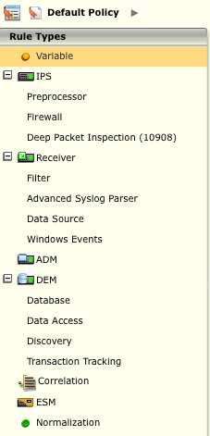
Rule Types
The Rule Types pane of the Policy Editor dialog allows you to access all of the rules by type.
You can import, export, add, edit, and perform various operations on a rule once it has been selected.
The functions that you can perform are limited by the type of rule.

Slide 25
Rule Types
All rules are based on a hierarchy system in which each rule inherits its usage from its parent.
The rule is marked with an icon to indicate from where it inherits its usage, and the icon will have a dot on the lower left corner if the inheritance chain has been broken somewhere beneath the current row.
The inheritance icon. Inherit indicates that the usage for this item is determined by the parent’s setting. Most rules are set to Inherit by default, but the usage can be changed to any level.
Indicates the inheritance chain has been broken at this point and the inheritance value is turned off. Note that the current rule usage will be used when the inheritance chain has been broken.
Indicates the inheritance chain has been broken at this level. Items below this point will not inherit any further up the chain than this. This setting is useful to force rules to use their default usage.
Indicates a custom value; you have set the value to something other than the default.

Slide 26
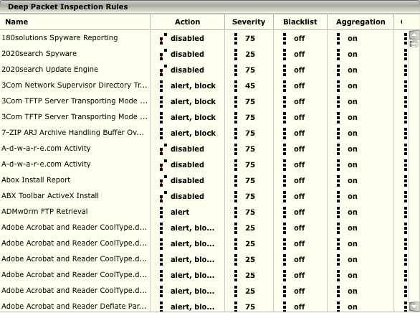
Rules Display Pane
Rule Display pane shows five different rule properties, seen as columns, consisting of:
Action
Severity
Blacklist
Aggregation
Copy Packet
Notes:
When a rule type (except for Variable and Preprocessor) is selected in the Rule Types pane, the Rule Display pane shows five different rule properties, seen as columns, consisting of Action, Severity, Blacklist, Aggregation, and Copy Packet. These columns are used to set specific rule parameters.
You can change the setting for each rule in each of these columns by clicking on the current setting and selecting a new one from the drop-down list.
In addition, you can change the setting for more than one rule at a time as follows:
1. Select the rules to be modified in one of the following ways:
a. Create a list of the rules to be changed using the filters available in the Filters/Tagging pane.
b. Highlight the rules to be changed using the Shift and Ctrl keys to select multiple rules.
2. Click on the header in the column whose setting you wish to change or click on the current setting for one of the highlighted rules in the column to be changed.
3. Select the new setting from the drop-down list. The Change Action dialog will open.
4. Select one of the two options on this dialog. If you have highlighted the rules to be changed, click on Apply only to the selected rules. If you set up filters so that this list contains only those rules whose action you want to change, click on Apply to the entire filtered set for this rule type.
5. Click OK. The setting will be changed.

Slide 27
Rule Properties - Settings
Action
Each rule’s usage is defined by a specified action. This action can be changed and set by clicking on the rule’s action in the Policy Editor and selecting the desired action from the drop-down menu.
Severity
Allows you to define the rule portion of the event severity when the rule is triggered. Severity is based on 1 to 100 value with 100 being the most severe.
Blacklisting
Allows you to have a blacklist entry auto created on a per rule basis when the rule is triggered on the device.
Aggregation
This column allows per rule aggregation for events that are created when a rule is triggered.
Copy packet
Allows you to copy packet data to the ESM. This is useful in the event of lost communication between the ESM and Receiver.
Notes:
Action
Each rule’s usage is defined by a specified action. This action can be changed and set by clicking on the rule’s action in the Policy Editor and selecting the desired action from the drop-down menu. The available actions vary based on the type of rule selected. The possible actions are: Inherit parent value; Block inheritance above this point; Pass; Alert; Block; Alert, Block; Enabled; Disabled; Alert, Block, Reset; False positives; sdrop; reject; drop; alert-sdrop; alert-drop; alert-reject; emergency; critical; failure; error; warning; stop; infected; denied; quarantine-fail; move-fail; remove-fail; clean-fail; quarantine; move; remove; clean; modify; add; untrusted; trusted; continue; restart; start; success; health; notice; informational; debug.
Severity
Severity allows you to define the rule portion of the event severity when the rule is triggered. Severity is based on 1 to 100 value with 100 being the most severe. To change the severity of a rule, click on the rule’s current severity number and select Custom severity value. The Edit Severity dialog will open. Move the arrow indicator to the desired position. Once you have selected the desired severity level, click OK.
Blacklist
Blacklisting allows you to have a blacklist entry auto created on a per rule basis when the rule is triggered on the device. To turn blacklisting on, select the rule you wish to change and click on the setting in the Blacklist column. A popup menu appears, which allows you to click on the desired operation. You can choose to blacklist only the IP address or the IP address and port.
Continued on next page

Slide 28
Hidden
Notes:
Aggregation
This column allows per rule aggregation for events that are created when a rule is triggered. Aggregation can be turned on or off by selecting a rule, clicking on the current setting in the Aggregation column, and selecting on or off. The aggregation settings defined on the Event Aggregation dialogs will only apply to those rules that are set to "on" in the Policy Editor.
Copy Packet
Copy packet allows you to copy packet data to the ESM. This is useful in the event of lost communication. If there is a copy of the packet data, you would be able to access the information by retrieving the copy. By default, the setting is turned to Off. To turn on the copy packet setting, select the rule you wish to change and click on the current Copy Packet setting for that rule. Select On from the drop-down menu. Note that inheritance still applies to this setting.

Slide 29
Rule Variables
A variable is a global setting or a placeholder for user or site specific information.
Variables are used to make rules behave in a specific way, which may vary from device to device.
The ESMI has many pre-set variables, but also provides you with ability to add custom variables.
When adding a rule, these variables will appear as options in the drop-down list for the field type selected in the Type field on the New Variable dialog.
Each variable has a default value, but some variable’s values should be set corresponding to the environment of each specific device. No spaces are allowed when entering a variable name.
If a space is necessary, use the “_” (underscore) symbol.
In order to maximize the effectiveness of a device, it is particularly important to set the HOME_NET variable to the home network being protected by the specific device.
Notes:
Many rules use variables. A variable is a global setting or a placeholder for user or site specific information. Variables are used to make rules behave in a specific way, which may vary from device to device. The ESMI has many pre-set variables, but also provides you with ability to add custom variables. When adding a rule, these variables will appear as options in the drop-down list for the field type selected in the Type field on the New Variable dialog.
Each variable has a default value, but some variable’s values should be set corresponding to the environment of each specific device. No spaces are allowed when entering a variable name. If a space is necessary, use the “_” (underscore) symbol. In order to maximize the effectiveness of a device, it is particularly important to set the HOME_NET variable to the home network being protected by the specific device.

Slide 30
Common list of Variables
The table shown below is a list of common variables and their default values.
Variable Name | Description | Default Value | Default Description
EXTERNAL_NET | Everyone outside of the protected network | !$HOME_NET | Any address except the HOME_NET address
HOME_NET | Local protected network address space | Any | Any address (not recommended)
HTTP_PORTS | Web server port(s) | 80 | Port 80
HTTP_SERVERS | Address(es) of web servers | $HOME_NET | Same as HOME_NET
SHELLCODE_PORTS | Anything but web server port(s) | !$HTTP_PORTS | Any port except the HTTP_PORTS
SMTP | Mail server address(es) | $HOME_NET | Same as HOME_NET
SMTP_SERVERS | Mail server address(es) | $HOME_NET | Same as HOME_NET
SQL_SERVERS | Address(es) of SQL DB servers | $HOME_NET | Same as HOME_NET
TELNET_SERVERS | Address(es) of telnet servers | $HOME_NET | Same as HOME_NET

Slide 31
IPS Firewall Rules
Firewall Rules are used to detect network events based on packet information such as protocol, port, or IP address on a Nitro IPS.
The firewall policy scans incoming packets and makes decisions based on initial information found before the packet is passed to the deep packet inspection engine.
Firewall rules will block things like spoofed and invalid IP addresses.
Firewall rules also track the rate and size of network traffic.

Slide 32
6 Types of Firewall Rules
ANOMALY The devices are designed to detect anomalies. Many of the anomaly-based rules coincide with one another and are used in conjunction with the values set in the Variables tab.
ANTI-SPOOF This is designed to detect invalid IP addresses. For example, if a reserved internal IP address is seen entering the network through a device, then the anti-spoof rule would be triggered.
BLACKLIST This determines the action to be taken on packets that are being sent to/from a blacklisted IP address or port.
DHCP This enables the user to turn on/off the capability to allow DHCP traffic through a device.
IPv6 This rule set detects IPv6 traffic.
PORT-BLOCK This allows the ability to block certain ports.

Slide 33
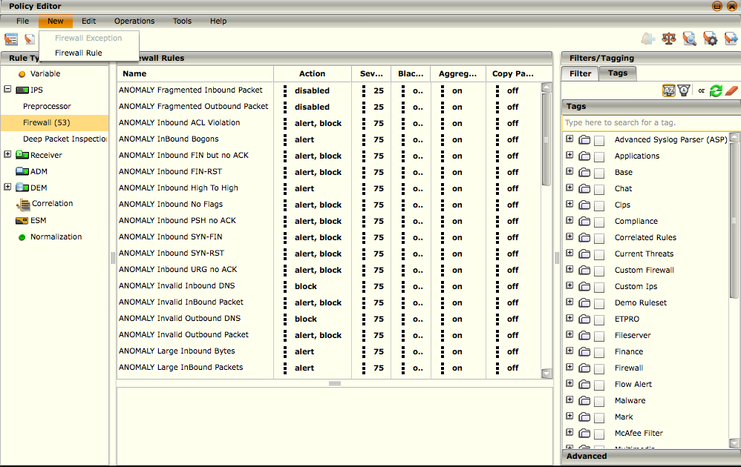
Adding a Custom Firewall Rule
To add a custom firewall rule:
Access the Policy Editor by clicking on the Policy Editor icon in the Actions Toolbar.
In the Rule Types pane, click on the Nitro IPS expansion icon and select Firewall.
Click on New in the toolbar menu and select Firewall Rule to open Firewall Rule.

Slide 34
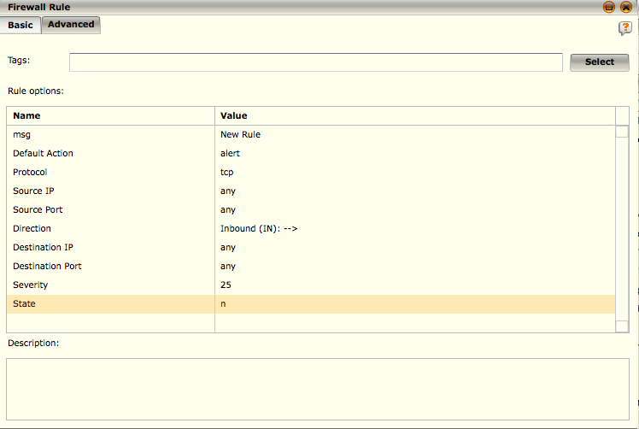
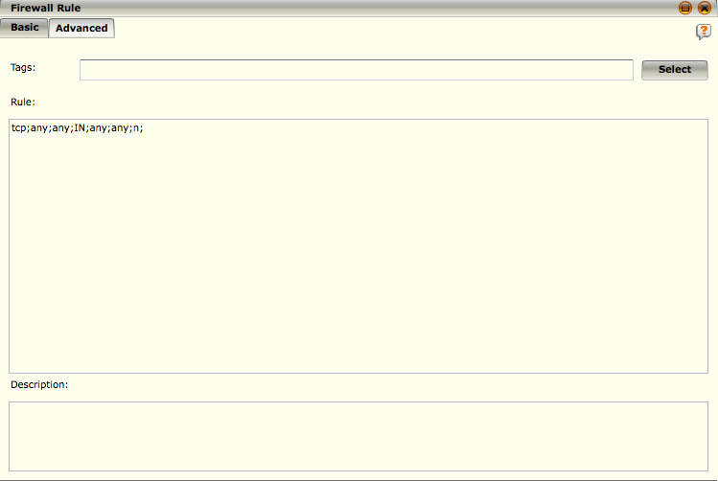
Adding a Custom Firewall Rule Cont.
The Firewall Dialog Box has two tabs available, Basic and Advanced.
NOTE
McAfee strongly recommends you have extensive knowledge of Snort format before attempting to add or modify firewall rules.
Notes:
Switching back and forth between the tabs will cause changes made in one to be reflected in the other.
The Basic tab shows the default action for the rule. You can add tags to define the categories to which the rule belongs by clicking on Select. In addition, you can change the value of each of the rule options by clicking on the value in the Value column and typing in or selecting a new value.
The Advanced tab allows you to modify the new rule by editing the text of the rule directly. The rule is kept in standard Snort format for ease of use.

Slide 35
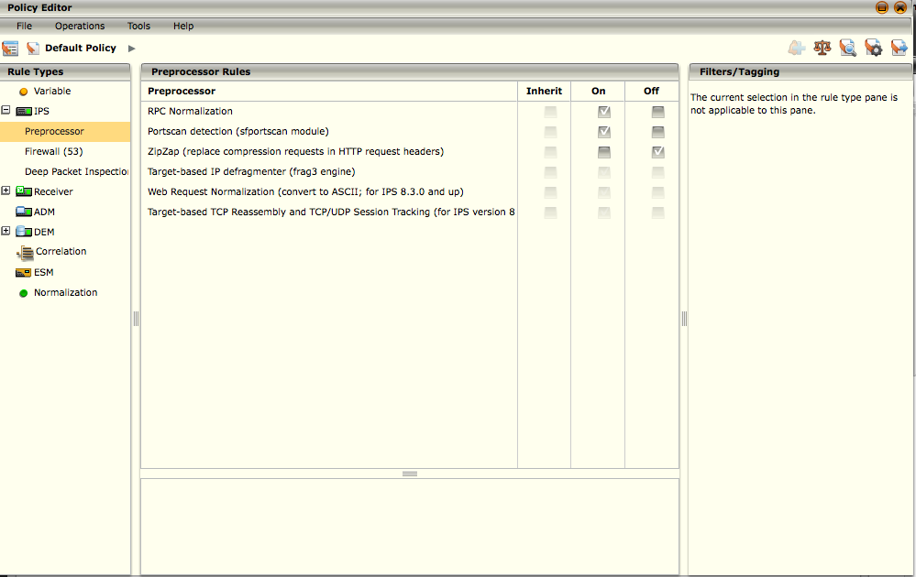
Preprocessor Rules
Preprocessors provide a way to unify the anomaly detection and packet inspection in the McAfee Nitro IPS and IDS.
Preprocessors are vital to the accurate detection of many rules.
Use ONLY the preprocessors that apply to your network configuration.
Notes:
To access the preprocessors:
1.Click on the Policy Editor icon on the Actions Toolbar. The Policy Editor opens.
2.In the Rule Types pane, click on Nitro IPS.
3.Click on Preprocessor. A list of the preprocessors will appear in the Preprocessor Rules pane.

Slide 36
Preprocessor Types
RPC Normalization
Normalize RPC protocol-specific traffic into a uniform way for detection purposes only. This preprocessor can prevent RPC fragmentation-related attacks from bypassing the Nitro IPS.
Port scan Detection
Generates an event if it detects a Port scan
ZipZap
Forces web servers to return data in raw, uncompressed and analyzable format
Target-based IP Defragmenter
Normalizes web requests into a uniform way for detection purposes only.
Target-based TCP Reassembly and TCP/UDP Session Tracking
Tracks sessions. It is a Snort based Stream5 preprocessor so the rule flow and flowbits keywords are usable with TCP as well as UDP traffic.
Notes:
The RPC Normalization preprocessor will normalize RPC protocol-specific traffic into a uniform way for detection purposes only. This preprocessor can prevent RPC fragmentation-related attacks from bypassing the Nitro IPS.
Port scan Detection - By enabling the Port scan detection preprocessor, it will generate an event if it detects a Port scan on the devices on the trusted side of your network. Once you have correctly set the HOME_NET variable, you should modify the variable SFPORTSCAN_PARMS (Variables > preprocessor) to read:
proto { all } scan_type { all } sense_level { medium } ignore_scanners { $HOME_NET }
HOME_NET cannot be set to “any” for ignore_scanners to work properly.
This is added to the sfportscan variable to eliminate what the Nitro IPS recognizes are port scans from the HOME_NET. Networks that place the Nitro IPS or IDS near a router or firewall that does Network Address Translation (NAT) will appear to be port scanning to the McAfee IPS. Modifying the variable reduces what looks like false positive events.
When serving web (HTTP) content, many web servers accept requests from web browsers indicating that the web content can be compressed before it is sent. While this saves network bandwidth, compressed web pages cannot be analyzed by a device. The ZipZap preprocessor will cause the web server to return this data in a raw, uncompressed and analyzable format. It should be noted that enabling this preprocessor will increase the amount of bandwidth used by web traffic
Target-based IP Defragmenter - A target-based preprocessor system models the actual targets on the network instead of merely modeling the protocols and looking for attacks within them. It uses the sfxhash data structure and linked lists for data handling internally, allowing it to have predictable and deterministic performance in any environment, which should aid in managing heavily fragmented environments.
Continued on next page

Slide 37
Hidden
Notes:
The Web Request Normalization preprocessor will normalize web requests into a uniform way for detection purposes only. It is always enabled; however, you are not allowed to make changes. There are two types of Web Request Normalization preprocessors, one for use with versions up to 8.2.x and the other for 8.3.0 and up. This preprocessor will catch attacks among the following:
Web directory traversal attacks (http://something.com/./attack.cmd)
Double-encoded strings (http://something.com/%25%32%35%25%33%32%25%33%30attack.cmd)
Unicode normalization
Invalid characters in a web request URL
Target-based TCP Reassembly and TCP/UDP Session Tracking - This preprocessor tracks sessions. It is a Stream5 preprocessor so the rule flow and flowbits keywords are usable with TCP as well as UDP traffic.

Slide 38
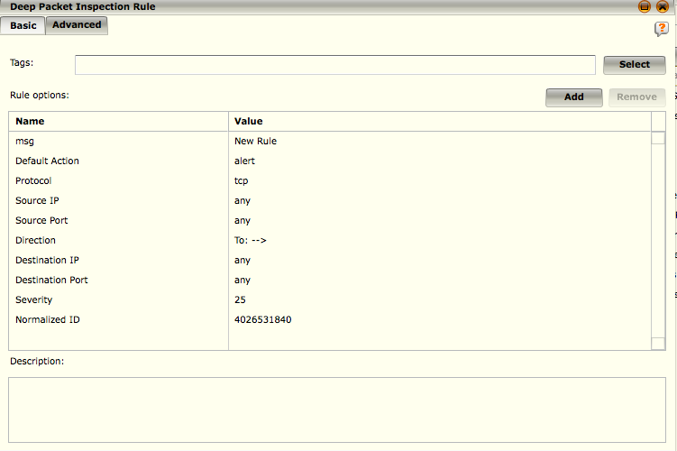
Deep Packet Inspection Rules
Deep-packet inspection rules evaluate the contents of a packet and compare them with patterns in the rule signatures.
When there is a pattern match, the specified action within the rule will be taken.
Typically, the default rules are sufficient for protecting the network.
There may be an occasion where rules specific to a protected system or environment are required.
Notes:
The BASE filter (in the Filters/Tagging pane) provides protection against known intrusions that may be damaging to a system or its data. The same is true for the MALWARE and VIRUS filters. Other filters such as POLICY and MULTIMEDIA inhibit or alert on network activities associated with user-defined network usage specifications and are not associated with potentially dangerous network intrusions.
General filter group types are as follows:
Protective rules (BASE, MALWARE, PERIMETER, VIRUS)
Policy rules (CHAT, MULTIMEDIA, PEERTOPEER, POLICY, SECURE APPLICATION GATEWAY).
Adding a Custom Deep Packet Inspection Rule
1.Access the Policy Editor by clicking on the Policy Editor icon () in the Actions Toolbar.
2.In the Rule Types pane, click on the Nitro IPS expansion icon () and select Deep Packet Inspection Engine.
3.Click on New in the toolbar menu and select Deep Packet Inspection Rule. The Deep Packet Inspection Rule dialog will open.
4.Click OK to add the rule. The filters in the rule will be applied and the new rule will appear in the Rule Display pane. To clear the filter and go back to displaying all of the deep packet inspection rules, click on the orange filter icon () in the top right corner of the Rule Display pane.

Slide 39
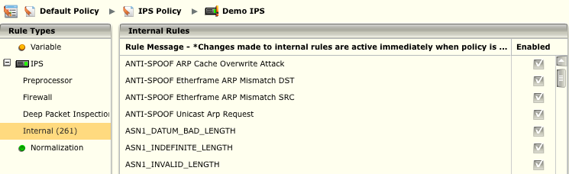
Internal Rules
The Internal rule type contains certain rules with signature IDs between 3,000,000 and 3,999,999, which are internal alerts and do not have signatures like other rules do.
These rules can ONLY be enabled or disabled.
The Internal rule type is only available when a Nitro IPS or virtual device is selected in the System Navigation Tree.
Notes:
To view the internal rules section, follow the steps below.
1. In the System Navigation Tree, select the Nitro IPS or virtual device you wish to modify.
2. Click on the Policy Editor icon in the Actions Toolbar. The Policy Editor dialog appears.
3. Click on Internal in the Rule Types pane. The internal rules appear in the Rule Message list.
4. To change the status of the rule, click on the Enabled checkbox for the rule you want to change.

Slide 40
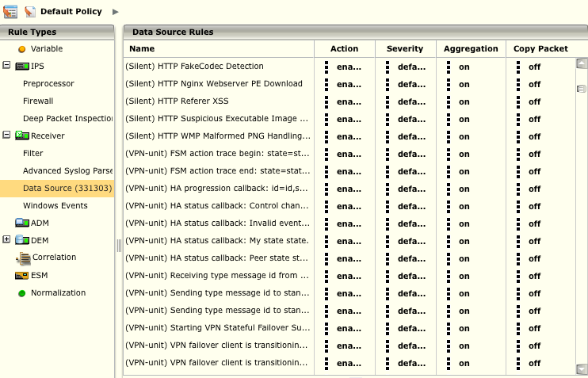
Data Source Rules – Auto Learned
When you click on the Data Source rule type on the Policy Editor, you will see rules that have been Auto Learned by a Receiver.
The Receiver auto-learns these rules as it processes the information sent to it by the data sources that are associated with the Receiver.
Notes:
The Data Source option in the Rule Types pane is only visible when a policy, data source, Advanced Syslog Parser, or Receiver is selected. It contains a description area which is located at the bottom of the dialog. This description area gives detailed information concerning the current rule you have selected and the description of that rule if one is defined.
All rules have a severity setting which dictates the priority associated with a rule. The priority impacts how the alerts generated for these rules are shown for reporting purposes.
Editing Data Source Auto Learned Rules
1. Access the Policy Editor by clicking on the Policy Editor icon in the Actions Toolbar.
2. In the Rule Types pane, click on the Receiver expansion icon and select Data Source.
3. Click on Edit in the toolbar menu and select Modify. The Modify Rule dialog appears.
4. Make the desired changes (modify the name, description, or Normalized ID.
5. Click OK to save the information.
Purging Auto-Learned Data Source Rules
1. Access the Policy Editor by clicking on the Policy Editor icon in the Actions Toolbar.
2. In the Rule Types pane, click on the Receiver expansion icon and select Data Source.
3. To delete selected auto-learned rules, select the rules that you want to delete and click on Edit, then Delete.
4. To purge auto-learned rules that you define, click on Edit in the toolbar menu and select Purge Rules. The Purge Rules screen will open.
Continued on next page

Slide 41
Hidden
Notes:
Select one of the following options:
• Purge all auto learned rules for this data source type - Click on this radio button to delete all of the rules that have been auto learned so far for the selected data source.
• Purge all auto learned rules previous to this time - Click on this radio button to delete the rules that were auto learned prior to the data that you enter in the field.
• Purge all auto learned rules previous to the system retention time - Click on this radio button to delete the rules that were auto learned prior the date that you have set as the system retention time. If you need to change the data retention time, click on the Edit button and make the desired changes on the Data Retention screen. See the Data Retention section for details.
6. Click on OK to save the settings and perform the selected function.

Slide 42
Windows Events Rules
Windows events rules are used to generate events that are Windows related.
They have been separated from the data source rule type because they are a common use case and rules of this type are defined by McAfee.
You cannot add, modify, or delete them. You can, however, change the settings in the columns of the Rules Display table.
Action - Allows you to enable or disable a rule. Click on the current setting for the desired rule and select Enable or Disable from the list that pops up.
Severity - Allows you to define the rule portion of the event severity when the rule is triggered. Severity is based on 1 to 100 value with 100 being the most severe.
Aggregation - Allows per rule aggregation for events that are created when a rule is triggered.
Copy Packet - Allows you to copy packet data to the ESM.

Slide 43
Advanced Syslog Parser Rules
The Advanced Syslog Parser (ASP) Rule Editor allows you to create custom ASP rules.
Advanced Syslog Parser provides a mechanism for parsing data out of syslog messages based on user-defined Rules.
Rules instruct the Advance Syslog Parser regarding how to recognize a given message and where in that message specific event data resides such as Signature IDs, IP addresses, ports, usernames, actions, etc.
This feature is ideal for custom application logs or modifying parsing options for built in McAfee ASP supported data sources
Knowledge of Regular Expressions is needed to use this feature.
Notes:
Add a Custom Advanced Syslog Parser Rule
To add an ASP rule, do the following:
1. Access the Policy Editor by clicking on the Policy Editor icon () in the Actions Toolbar.
2. In the Rule Types pane, click on the Receiver expansion icon () and select Advanced Syslog Parser.
3. Click on New in the toolbar menu and select Advanced Syslog Parser Rule. The Advanced Syslog Parser Rule Editor will open.

Slide 44
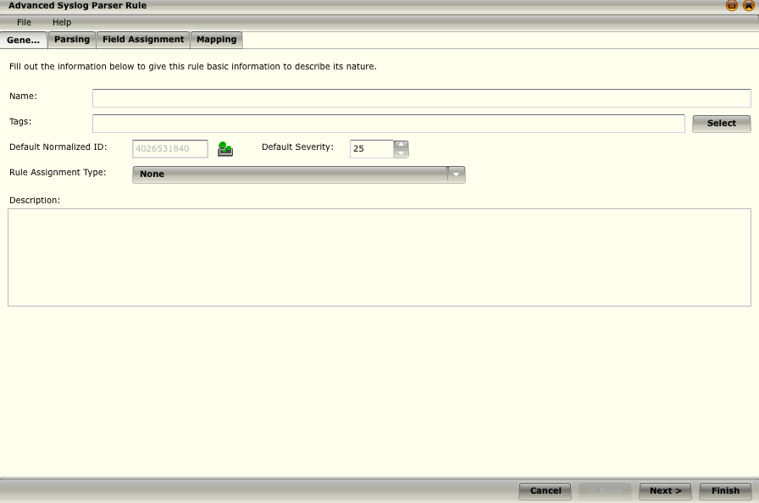
Advanced Syslog Parser Rules
The General Tab allows you to enter in the general information regarding the ASP rule such as:
Name
Tags
Normalization ID
Severity
Rule Assignment Type
Description
Notes:
Name - Enter a name for the rule. It has to contain a minimum of 1 character and a maximum of 256.
Tags - Add tags to define the categories to which the rule belongs by clicking on Select. Each ASP rule needs at least one tag selected in order for the rule to be saved.
Default Normalized ID - Select the normalized ID that you want associated with this rule. The default ID is 4026531840, which is Uncategorized. This ID will be used if the incoming log doesn't have an ID.
Default Severity - Enter the severity of this rule. Default severity is 25. This severity will get used if the incoming log data doesn't have a severity.
Rule Assignment Type - Select a default rule assignment type, which is used to group event data learned from the Advanced Syslog Parser and separate it from other data sources. It is beneficial to group devices with different rule types separately to prevent Signature ID collisions in the database (e.g., Event 30405 on a Cisco PIX has a different meaning than 30405 on a Cisco IOS or 30405 on a Snort IDS).
Description - Enter a description of the rule, if desired. The maximum length of the description is 1025 characters.

Slide 45
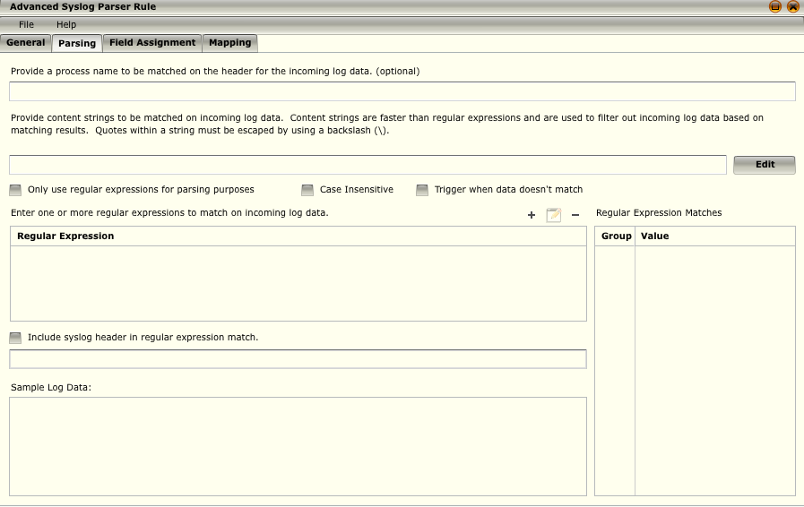
Advanced Syslog Parser Rules
The Parsing Tab is where you will enter the Regular Expression parsing logic for use within ASP
Note that you can enter multiple regular expressions into the ASP rule editor allowing you to further parse the log data
Notes:
Process name (optional) - Enter a name for the process which will be matched in the header on the incoming log data.
Content (optional) - Click on the Edit button to the right of this field. On the Content Strings dialog that opens, click on Add. On the Add Content String dialog, enter string values to perform a quick match against the content of the log data. The values must be enclosed by quotes (“”) and separated by commas (,). Quotes within a string must be escaped by using a backslash (\). You can edit or delete these strings on the Content Strings dialog. Content matches are typically faster than regular expressions.
When concatenating a literal value with a PCRE subcapture in versions 9.0.0 and above, put the literals in quotes individually if they contain spaces or other characters and leave the PCRE subcapture references unquoted.
Only use regular expressions check box - By default, the rule will trigger if the content string or the regular expression match. If you select this check box, it will only trigger if the content string matches.
Case Insensitive - If selected, the content is matched regardless of the case (i.e., upper or lower case).
Trigger when data doesn't match - Field assignment and mapping tabs will be disabled if you select this option. The rule will trigger but no data will be parsed.
Regular Expression – All of these regular expressions are used to match against incoming log data. This gives you the ability to do multiple matches on log data. These regular expressions will not get executed unless the first one in the list is executed and returns back a result from the log data. You can single select regular expression values within this table which will then highlight corresponding text matches within the sample data field along with making the selections to the right in the Regular Expression Matches table.
Add – This will launch a simple pop up window that will allow you to enter a regular expression.
Edit – Allows you to edit a regular expression.
Delete – Allows you to delete a regular expression.
Continued on next page

Slide 46
Hidden
Notes:
Regular Expression Matches table – This table will reflect the values that were extracted from the “Sample Log Data” when run against the primary and secondary regular expressions.
Include syslog header in regular expression match – If you want the regular expression matching to be done on the entire log data, click on this check box.
Header Text Input – Displays the syslog header.
Sample Log Data – You can copy and paste some sample log data into this field to help you create valid regular expressions.
Group/Value Table – This table will reflect the values that were extracted from the Sample Log Data when run against the expressions.

Slide 47
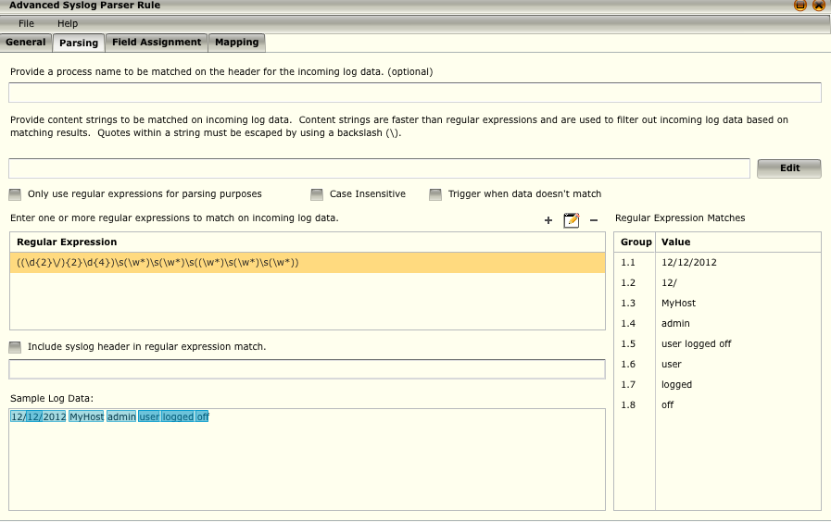
Advanced Syslog Parser Rules
The Parsing Tab is where you will enter the Regular Expression parsing logic for use within ASP parser
Note that you can enter multiple regular expressions into the ASP rule editor allowing you to further parse the log data
Sample Log Message: “12/12/2012 MyHost admin user logged out”
Sample Regex: “((\d{2}\/){2}\d{4})\s(\w*)\s(\w*)\s((\w*)\s(\w*)\s(\w*))”
Notes:
Process name (optional) - Enter a name for the process which will be matched in the header on the incoming log data.
Content (optional) - Click on the Edit button to the right of this field. On the Content Strings dialog that opens, click on Add. On the Add Content String dialog, enter string values to perform a quick match against the content of the log data. The values must be enclosed by quotes (“”) and separated by commas (,). Quotes within a string must be escaped by using a backslash (\). You can edit or delete these strings on the Content Strings dialog. Content matches are typically faster than regular expressions.
When concatenating a literal value with a PCRE subcapture in versions 9.0.0 and above, put the literals in quotes individually if they contain spaces or other characters and leave the PCRE subcapture references unquoted.
Only use regular expressions check box - By default, the rule will trigger if the content string or the regular expression match. If you select this check box, it will only trigger if the content string matches.
Case Insensitive - If selected, the content is matched regardless of the case (i.e., upper or lower case).
Trigger when data doesn't match - Field assignment and mapping tabs will be disabled if you select this option. The rule will trigger but no data will be parsed.
Regular Expression – All of these regular expressions are used to match against incoming log data. This gives you the ability to do multiple matches on log data. These regular expressions will not get executed unless the first one in the list is executed and returns back a result from the log data. You can single select regular expression values within this table which will then highlight corresponding text matches within the sample data field along with making the selections to the right in the Regular Expression Matches table.
Add – This will launch a simple pop up window that will allow you to enter a regular expression.
Edit – Allows you to edit a regular expression.
Delete – Allows you to delete a regular expression.
Continued on next page

Slide 48
Hidden
Notes:
Regular Expression Matches table – This table will reflect the values that were extracted from the “Sample Log Data” when run against the primary and secondary regular expressions.
Include syslog header in regular expression match – If you want the regular expression matching to be done on the entire log data, click on this check box.
Header Text Input – Displays the syslog header.
Sample Log Data – You can copy and paste some sample log data into this field to help you create valid regular expressions.
Group/Value Table – This table will reflect the values that were extracted from the Sample Log Data when run against the expressions.

Slide 49
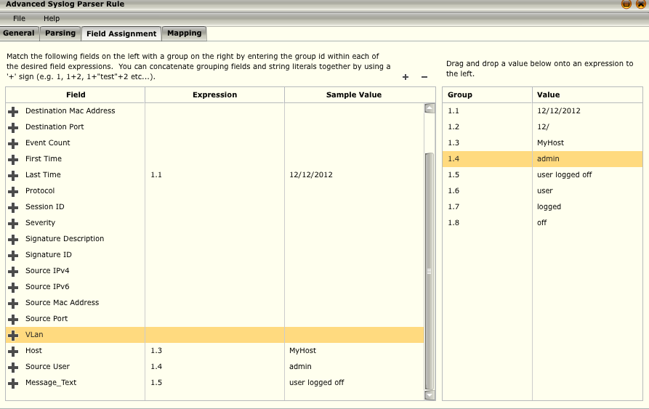
Advanced Syslog Parser Rules
The Field Assignment Tab allows you to map the parsed fields to the actual database fields within the SIEM
Note that you can concatenate two values together by using the “+” symbol.
Notes:
Field – This column contains the fields that you can match on. You can add field types to this column by clicking on the Add icon above the right corner of the table or delete them by highlighting a field type and clicking on the Delete icon. You can add fall-back fields by clicking on the add icon next to the field name. A fall-back field is used if the primary field is blank. Fall-back fields get executed in order so you can reorder the fields by dragging and dropping them. You can have up to 10 fall back fields. Once a fall-back field has been added, you can remove it by clicking on the delete icon to the left of the fall-back field name.
Expression – This column is used for mapping fields to log data values. Click on the Expression column and type in the group ID in the field that opens. You can concatenate two values together by using the “+” symbol.
Sample Value – This column is used to simulate what the final output will be for a specific field.
Group/Value Table – This table will reflect the values that were extracted from the Sample Log Data on the Parsing tab when run against the expressions. You can drag a value from this list and drop it on a Field. expression.
Add Custom Field and Delete Custom Field - If the field you need is not displayed in the Field column, click on the Add Custom Field icon. The Custom Types dialog will open listing all of the custom types on the system, including any you have added. Click on the field you want to add to the list and click OK. The field will be added to the table. If you want to delete a custom field from the list, click on the Delete Custom Field icon and click Yes on the confirmation dialog.

Slide 50
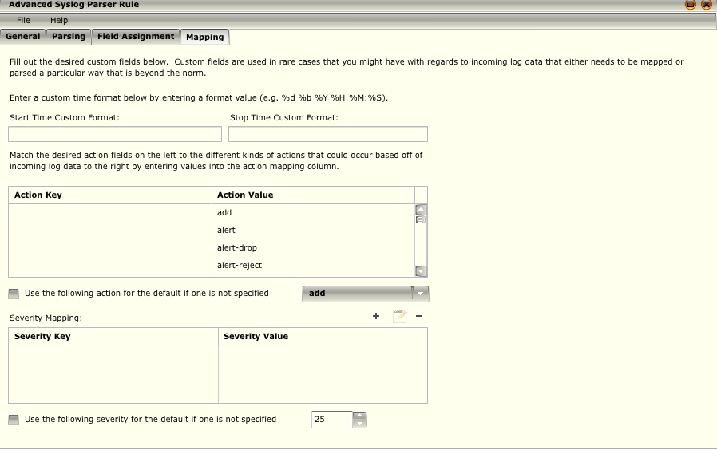
Advanced Syslog Parser Rules
The settings on the Mapping tab are used in the rare case that you need to define custom settings for incoming log data that needs to be mapped or parsed in a unique way
Notes:
The settings on the Mapping tab are used in the rare case that you need to define custom settings for incoming log data that needs to be mapped or parsed in a unique way.
• Start/Stop Time – You can enter a custom start and stop format. When you click on the desired field, a drop-down list will display the options. When you click on one, it is added to the field.
• Action table – The Actions Value column displays a list of all possible actions. Match the desired action in the Action Value column to the different kinds of actions that could occur by entering values into the Action Key column. To enter a value, click on the location in the Action Key column. A text field will open.
• Default Severity - If you want to set a default severity to be used if one is not selected in the Severity table, click on this check box and selected the desired severity.
• Severity table – You can add values that should get mapped from the incoming log data by clicking on the Add icon above the right corner of the table.

Slide 51
The policy change history log can hold a maximum of 1 GB of data. When it reaches this limit, the oldest files will be _____________ ?
Archived to a remote storage device
Compressed and archived on the ESM
Deleted
Compressed and emailed to the ESM admin account
Notes:
Answer: Deleted

Slide 52
The Tags feature on the Policy Editor dialog allows you to define the categories to which a rule belongs.
True
False
Notes:
Answer: True

Slide 53
By default the ESM HOME_NET variable is set to what?
!$EXTERNAL_NET
Any
10.0.0.0/16
192.168.1.0/24
Notes:
Answer: Any

Slide 54
You can edit, modify and delete Windows event rules within the McAfee Policy Editor.
True
False
Notes:
Answer: False - You cannot add, modify, or delete them. You can, however, change the settings in the columns of the Rules Display table.

Slide 55
Hands-on Practice Refer to the Practice Manual Practice 7: Using the Syslog Parser

